Slide 1
Random Variables and Probability Distributions
Chapter 3

Slide 2
Chapter 3
Chapter 3 moves on from the basics of probability to using what we learned in chapter 2 to lay the foundations for the theory we need for statistical inference.
We start by introducing the idea of a random variable in 3.1 and then spend sections 3.2-3.4 discussing probability distributions. Chapters 4, 5, and 6 cover these ideas in more detail, so understanding chapter 3 is critical moving forward in the class.

Slide 3
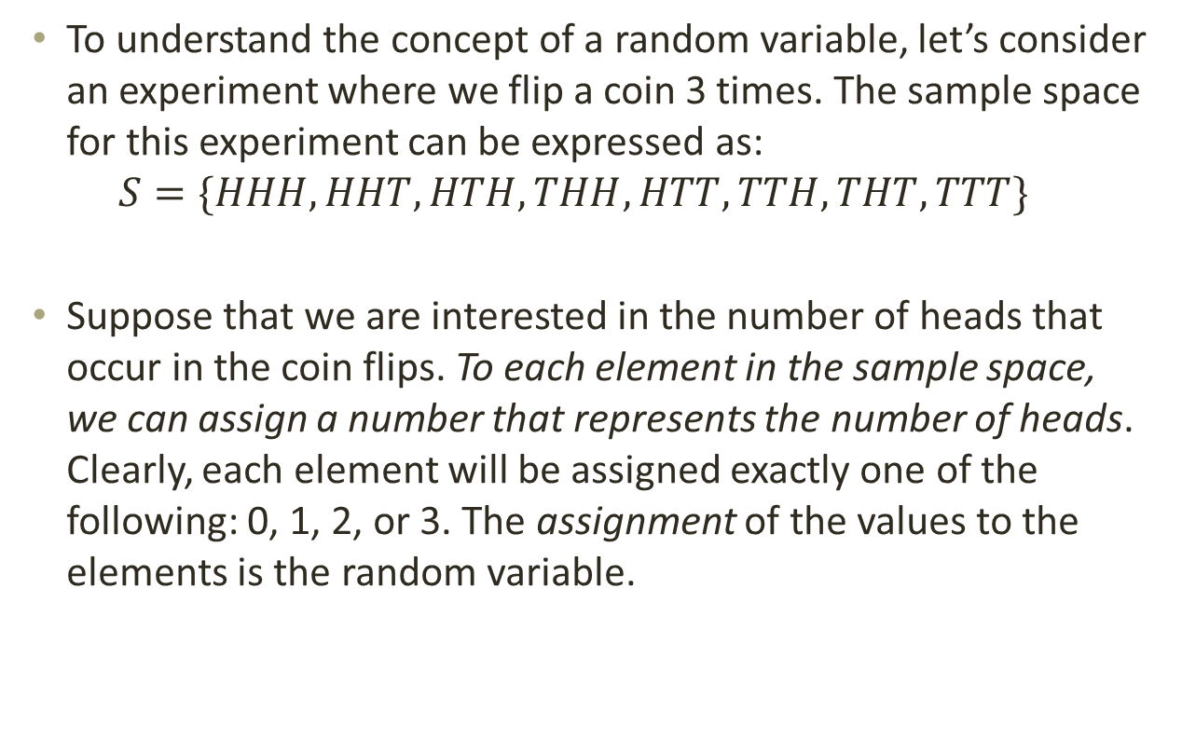
3.1 – Random Variables
To understand the concept of a random variable, let’s consider an experiment where we flip a coin 3 times. The sample space for this experiment can be expressed as:
$$S=\{HHH, HHT, HTH, THH, HTT, TTH, THT, TTT\}$$
Suppose that we are interested in the number of heads that occur in the coin flips. To each element in the sample space, we can assign a number that represents the number of heads. Clearly, each element will be assigned exactly one of the following: 0, 1, 2, or 3. The assignment of the values to the elements is the random variable.

Slide 4
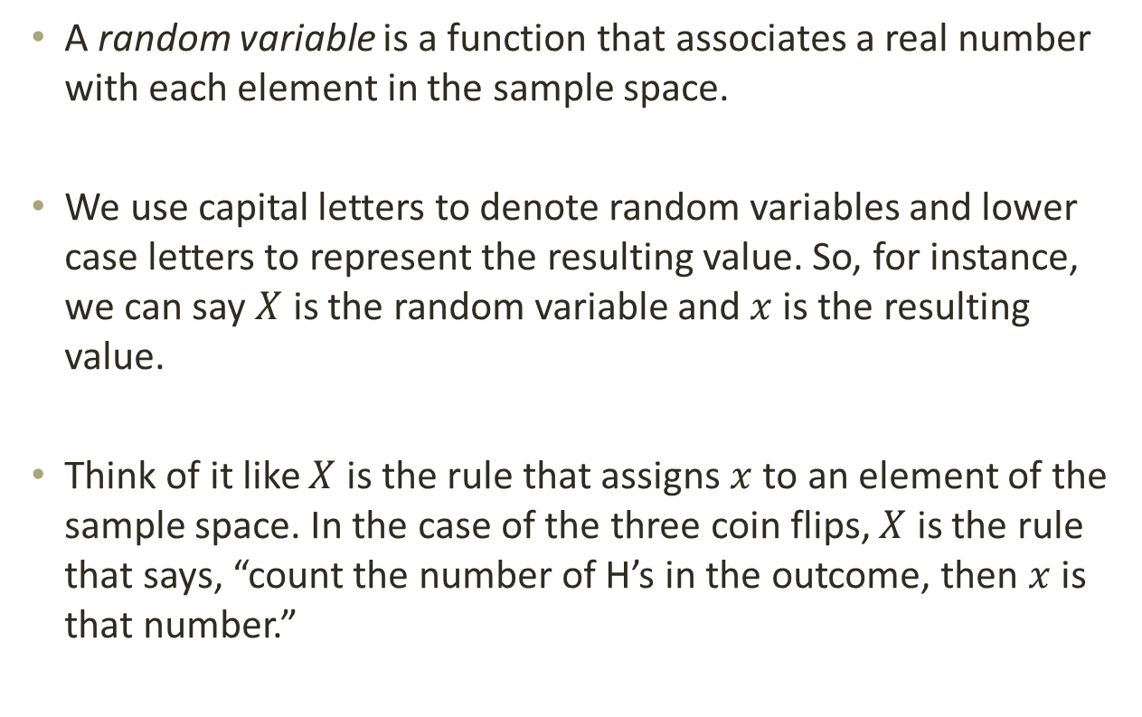
3.1 – Random Variables
A random variable is a function that associates a real number with each element in the sample space.
We use capital letters to denote random variables and lower case letters to represent the resulting value. So, for instance, we can say $X$ is the random variable and $x$ is the resulting value.
Think of it like $X$ is the rule that assigns $x$ to an element of the sample space. In the case of the three coin flips, $X$ is the rule that says, “count the number of H’s in the outcome, then $x$ is that number.”

Slide 5
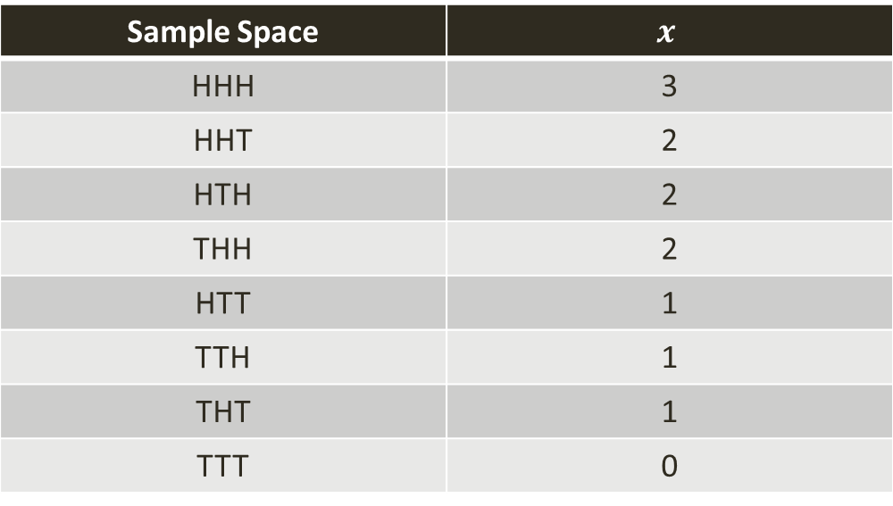
3.1 – Random Variables
Example: For the three coin flips experiment, we can express the random variable as follows:
Sample Space | $$x$$
HHH | 3
HHT | 2
HTH | 2
THH | 2
HTT | 1
TTH | 1
THT | 1
TTT | 0

Slide 6
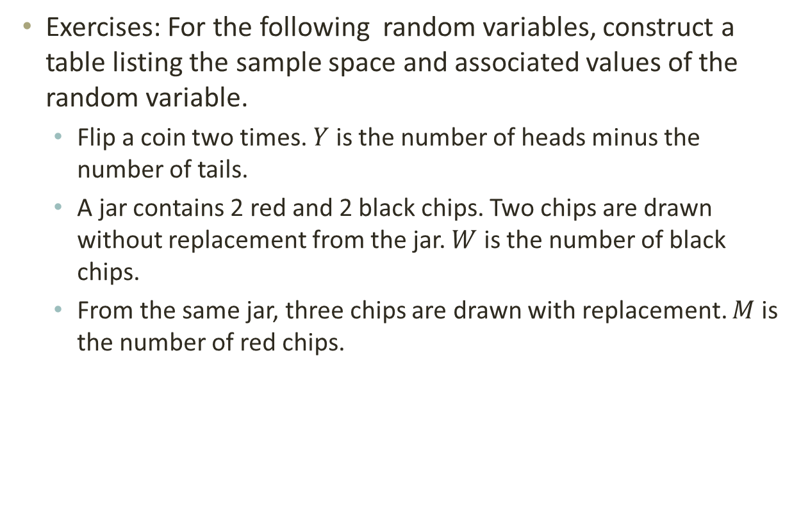
3.1 – Random Variables
Exercises: For the following random variables, construct a table listing the sample space and associated values of the random variable.
  Flip a coin two times. $Y$ is the number of heads minus the number of tails.
  A jar contains 2 red and 2 black chips. Two chips are drawn without replacement from the jar. $W$ is the number of black chips.
  From the same jar, three chips are drawn with replacement. $M$ is the number of red chips.

Slide 7
3.1 – Random Variables
There are two more important definitions from this section:
  If a sample space contains a finite number of possibilities or an unending sequence with as many elements as there are whole numbers (countably infinite), it is called a discrete sample space.
  If a sample space contains an infinite number of possibilities equal to the number of points on a line segment (uncountably infinite), it is called a continuous sample space.

Slide 8
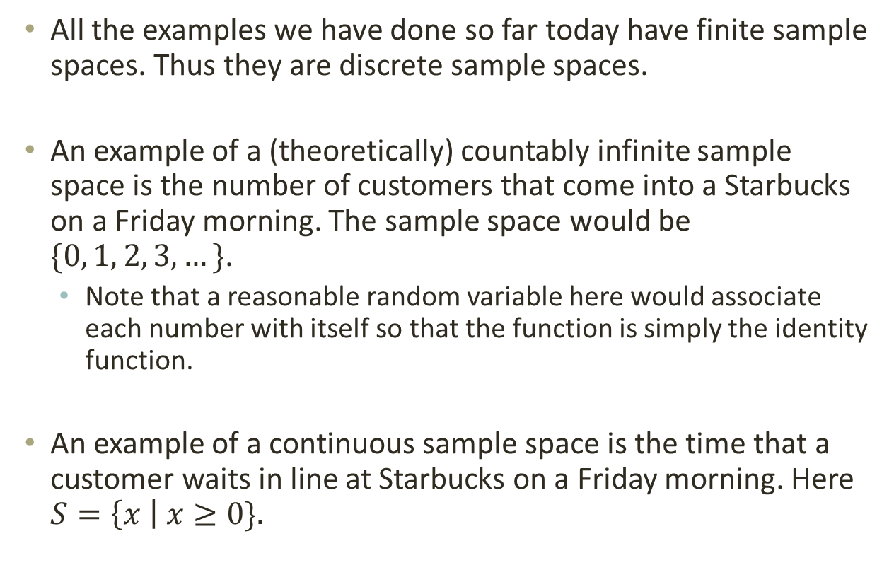
3.1 – Random Variables
All the examples we have done so far today have finite sample spaces. Thus they are discrete sample spaces.
An example of a (theoretically) countably infinite sample space is the number of customers that come into a Starbucks on a Friday morning. The sample space would be $\{0, 1, 2, 3, …\}$.
  Note that a reasonable random variable here would associate each number with itself so that the function is simply the identity function.
An example of a continuous sample space is the time that a customer waits in line at Starbucks on a Friday morning. Here $S=\left\{x \right| x≥0\}.$

Slide 9
3.1 – Random Variables
Related to these ideas, a random variable is a discrete random variable if its set of possible outcomes is countable. If a random variable can take on values on a continuous scale, it is a continuous random variable.
Exercise: Decide whether each of the following random variables is continuous or discrete:
  The number of violent crimes committed in a certain city in one month
  The amount of gasoline sold at a certain gas station in one week
  The length of a nail produced by a particular machine
  The number of defective products in a shipment

Slide 10
3.2 – Discrete Probability Distributions
We now use the idea of a random variable to introduce the concept of probability distributions. To understand the idea, let’s go back to the three coin flips example and add another column to the table that represents the probability of each element.

Slide 11
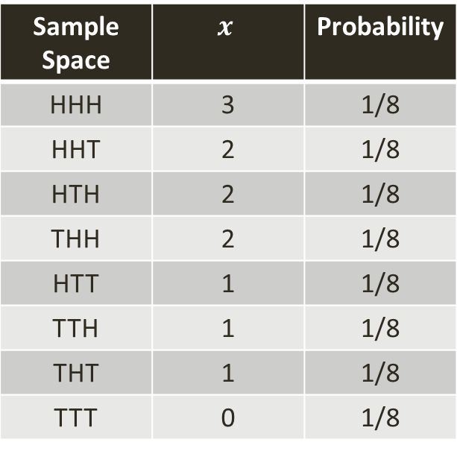

3.2 – Discrete Probability Distributions
This is done simply enough:
Now instead of listing the probabilities for each element, let’s get the probabilities of each realized value of the random variable. That is, we want $P(X=x)$.
Sample Space | $$x$$ | Probability
HHH | 3 | 1/8
HHT | 2 | 1/8
HTH | 2 | 1/8
THH | 2 | 1/8
HTT | 1 | 1/8
TTH | 1 | 1/8
THT | 1 | 1/8
TTT | 0 | 1/8

Slide 12
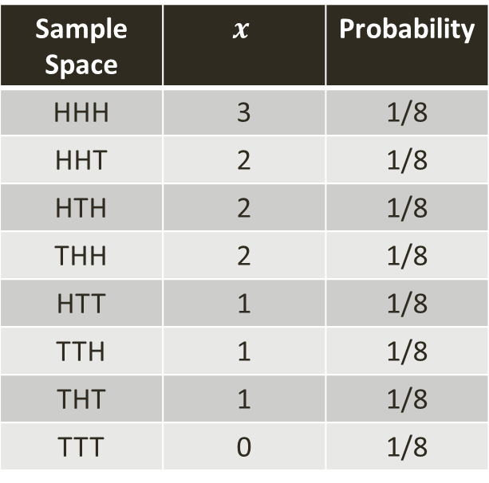
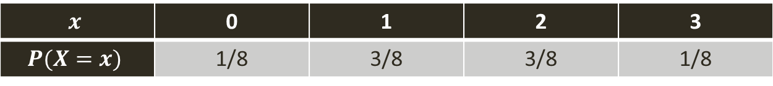
3.2 – Discrete Probability Distributions
$$x$$ | 0 | 1 | 2 | 3
$$P(X=x)$$ | 1/8 | 3/8 | 3/8 | 1/8
Sample Space | $$x$$ | Probability
HHH | 3 | 1/8
HHT | 2 | 1/8
HTH | 2 | 1/8
THH | 2 | 1/8
HTT | 1 | 1/8
TTH | 1 | 1/8
THT | 1 | 1/8
TTT | 0 | 1/8

Slide 13
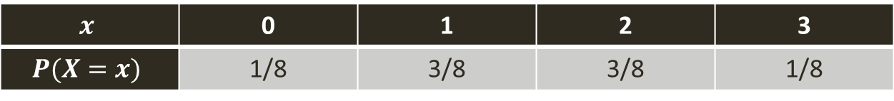
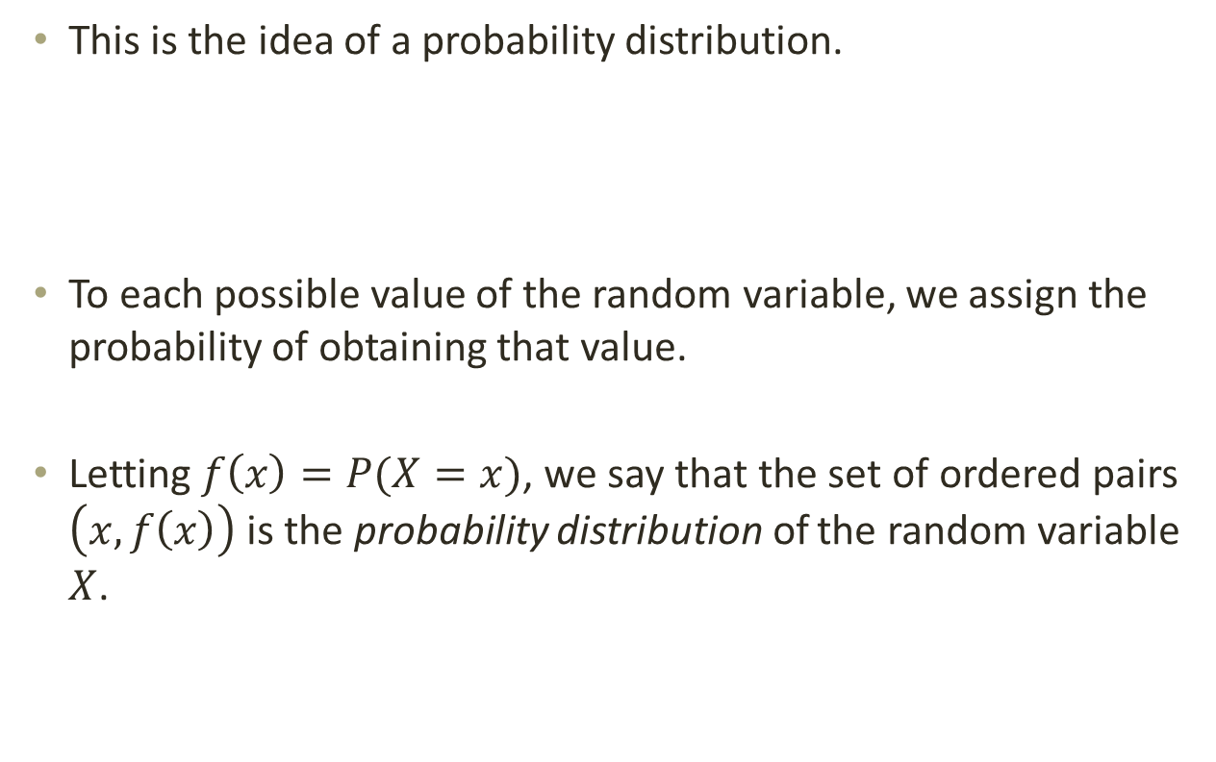
3.2 – Discrete Probability Distributions
This is the idea of a probability distribution.
To each possible value of the random variable, we assign the probability of obtaining that value.
Letting $f\left(x\right)=P(X=x)$, we say that the set of ordered pairs $\left(x, f\left(x\right)\right)$ is the probability distribution of the random variable $X$.
$$x$$ | 0 | 1 | 2 | 3
$$P(X=x)$$ | 1/8 | 3/8 | 3/8 | 1/8

Slide 14
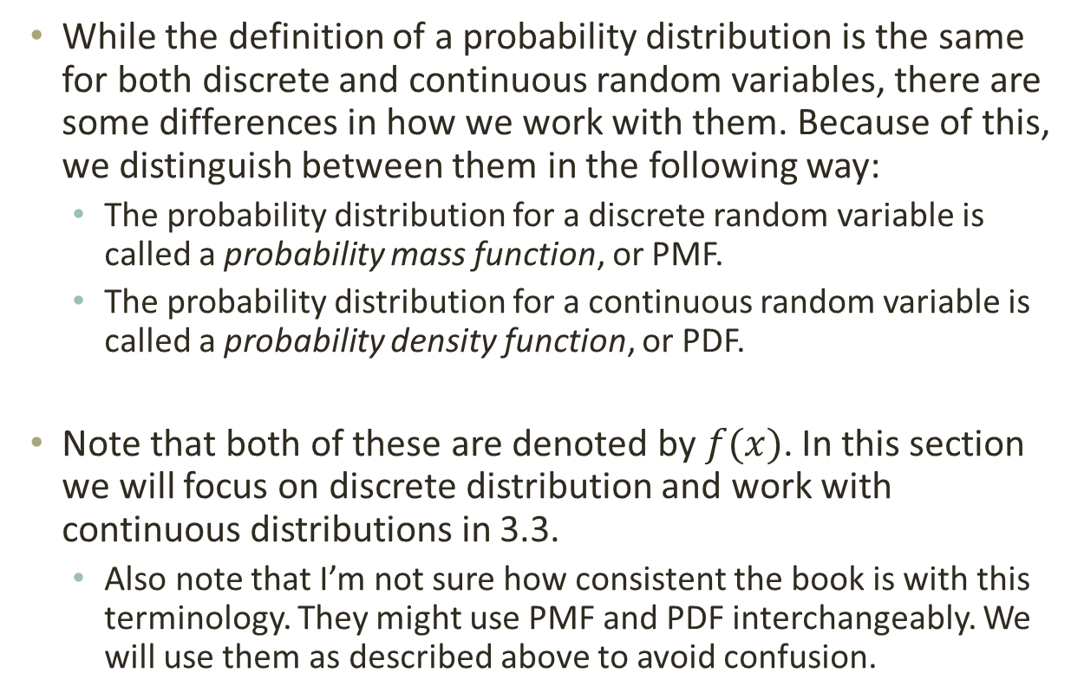
3.2 – Discrete Probability Distributions
While the definition of a probability distribution is the same for both discrete and continuous random variables, there are some differences in how we work with them. Because of this, we distinguish between them in the following way:
  The probability distribution for a discrete random variable is called a probability mass function, or PMF.
  The probability distribution for a continuous random variable is called a probability density function, or PDF.
Note that both of these are denoted by $f(x)$. In this section we will focus on discrete distribution and work with continuous distributions in 3.3.
  Also note that I’m not sure how consistent the book is with this terminology. They might use PMF and PDF interchangeably. We will use them as described above to avoid confusion.

Slide 15
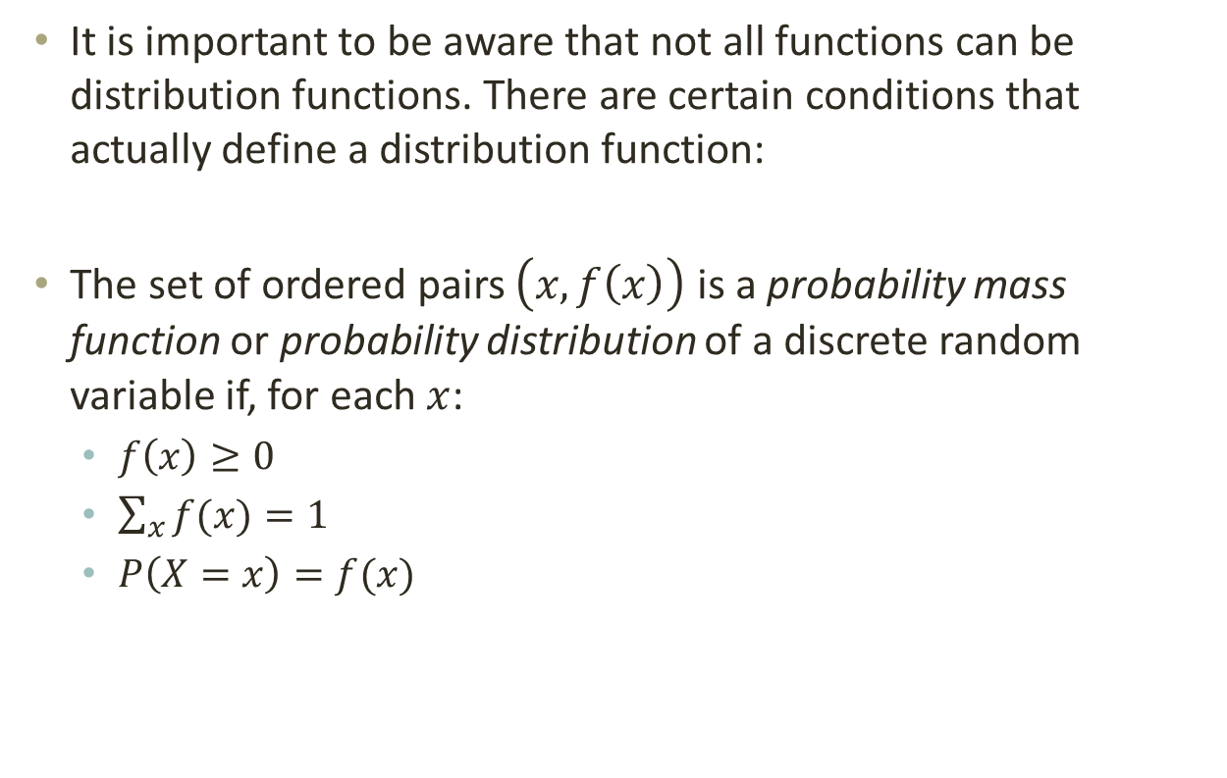
3.2 – Discrete Probability Distributions
It is important to be aware that not all functions can be distribution functions. There are certain conditions that actually define a distribution function:
The set of ordered pairs $\left(x, f\left(x\right)\right)$ is a probability mass function or probability distribution of a discrete random variable if, for each $x$:
  $f\left(x\right)≥0$
  $\sum_{x}{f(x)}=1$
  $P\left(X=x\right)=f(x)$

Slide 16
3.2 – Discrete Probability Distributions
The first two conditions are necessary for probabilities, as we defined in chapter two. The first means that we can’t have negative probability. The second condition requires that all the probabilities sum to 1 (which also implies that no probability can be larger than 1).
The final condition tells us how to calculate probability using the PMF. If we want to know the probability that the random variable takes on a particular value, we simply have to evaluate the PMF at that particular value.

Slide 17
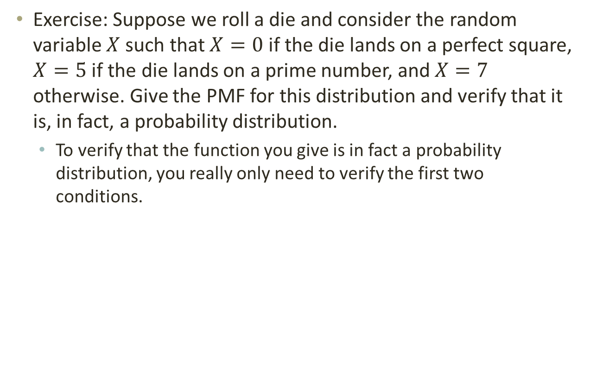
3.2 – Discrete Probability Distributions
Exercise: Suppose we roll a die and consider the random variable $X$ such that $X=0$ if the die lands on a perfect square, $X=5$ if the die lands on a prime number, and $X=7$ otherwise. Give the PMF for this distribution and verify that it is, in fact, a probability distribution.
  To verify that the function you give is in fact a probability distribution, you really only need to verify the first two conditions.

Slide 18
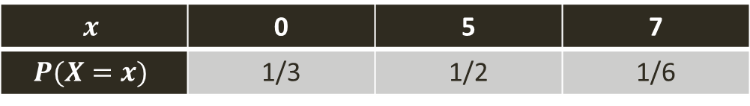
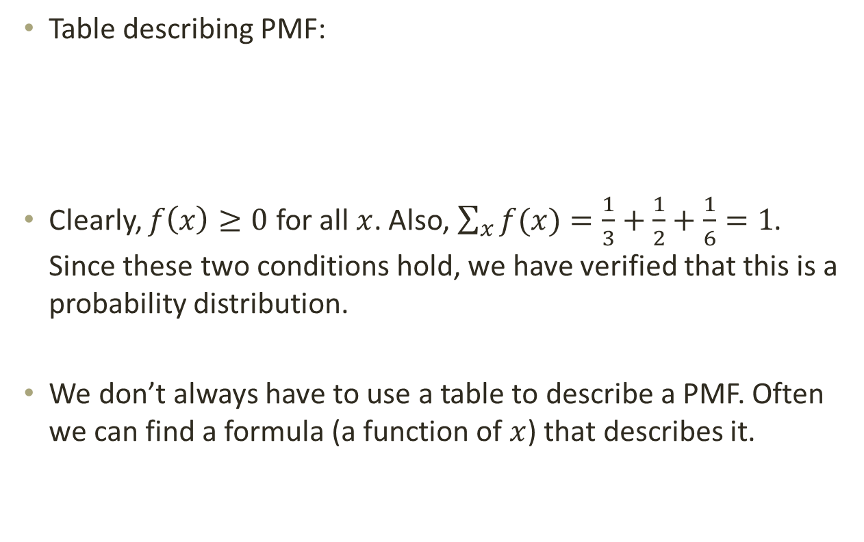
3.2 – Discrete Probability Distributions
Table describing PMF:
Clearly, $f\left(x\right)≥0$ for all $x$. Also, $\sum_{x}{f(x)}=\frac{1}{3}+\frac{1}{2}+\frac{1}{6}=1$. Since these two conditions hold, we have verified that this is a probability distribution.
We don’t always have to use a table to describe a PMF. Often we can find a formula (a function of $x$) that describes it.
$$x$$ | 0 | 5 | 7
$$P(X=x)$$ | 1/3 | 1/2 | 1/6

Slide 19

3.2 – Discrete Probability Distributions
Example: Come up with a formula that describes the probability distribution for the random variable $Y$ where $Y$ is the number of heads in 2 flips of a coin.

Slide 20

3.2 – Discrete Probability Distributions
A common type of problem that shows up is that you will see a formula for a probability distribution like $f\left(x\right)=\frac{cx}{6}, x=1, 2, 3, 4$. You are then asked to find $c$ so that this function is a valid PMF.
How do we find $c$?

Slide 21
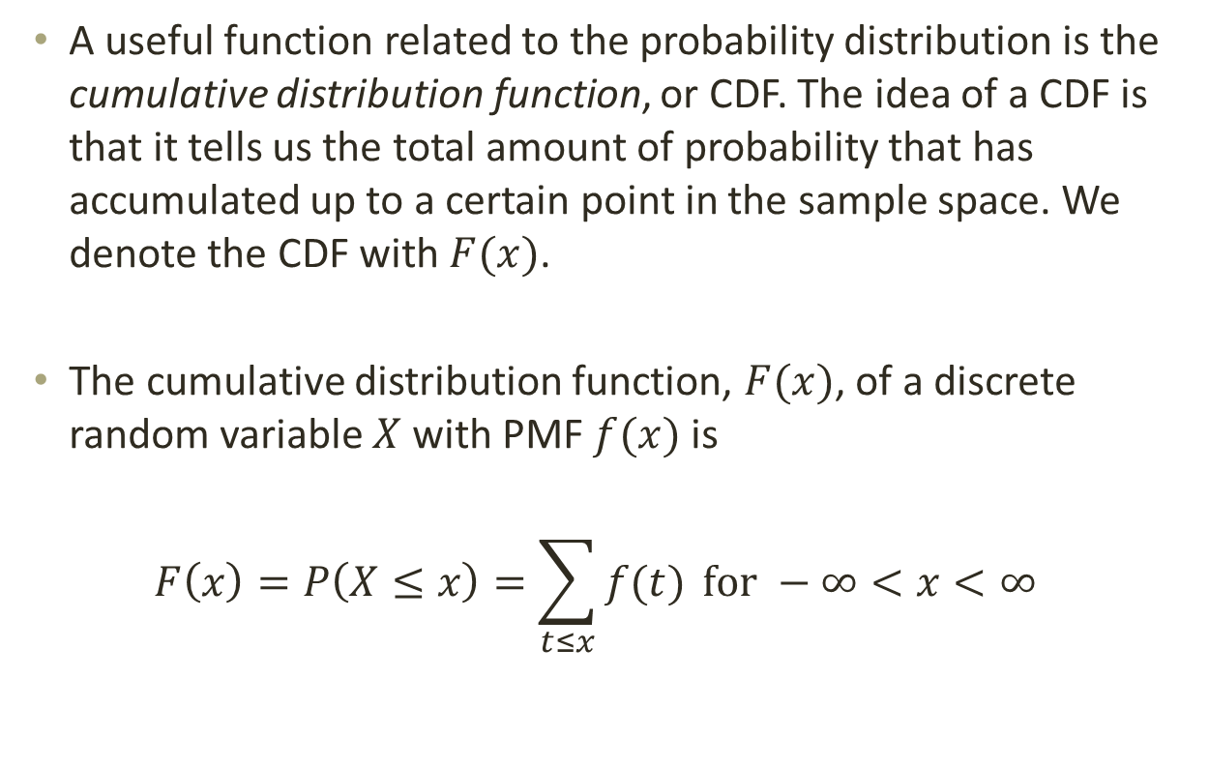
3.2 – Discrete Probability Distributions
A useful function related to the probability distribution is the cumulative distribution function, or CDF. The idea of a CDF is that it tells us the total amount of probability that has accumulated up to a certain point in the sample space. We denote the CDF with $F(x)$.
The cumulative distribution function, $F(x)$, of a discrete random variable $X$ with PMF $f(x)$ is
$$F\left(x\right)=P\left(X≤x\right)=\sum_{t≤x}{f(t)} for −∞<x<∞$$

Slide 22
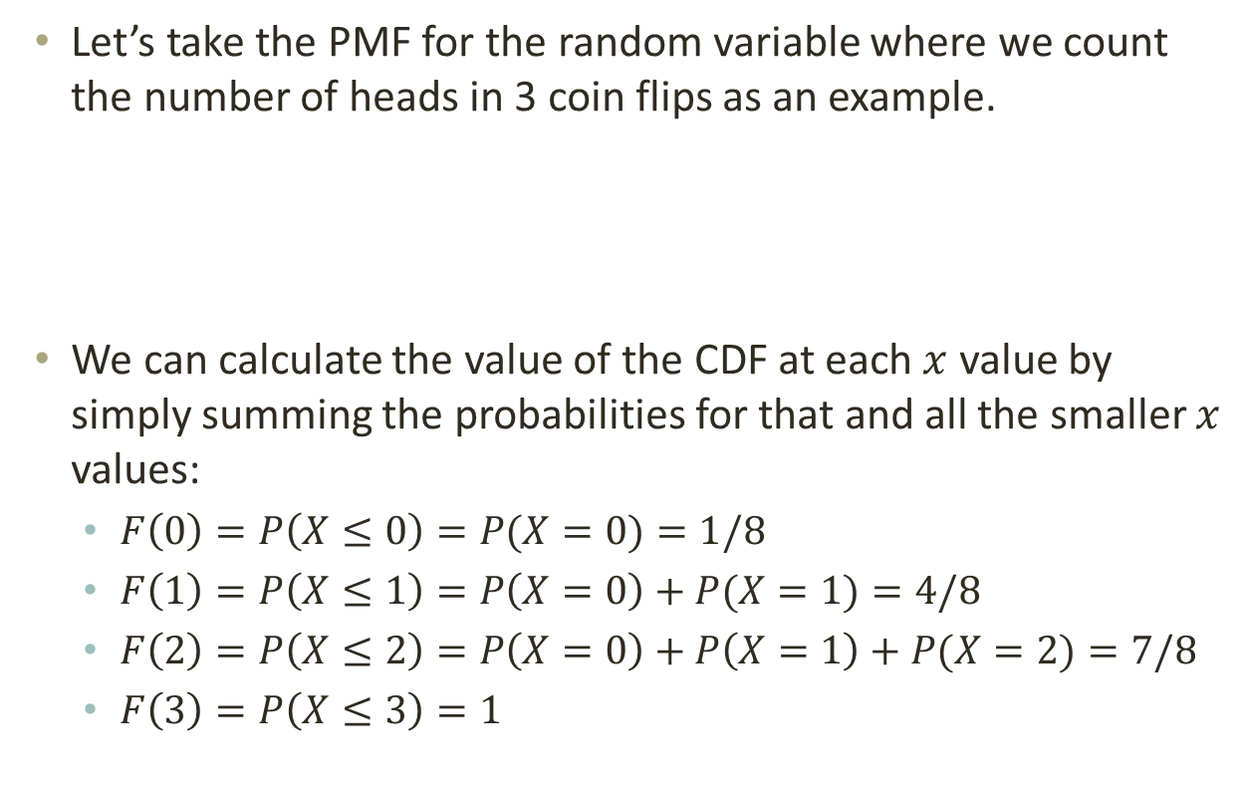
3.2 – Discrete Probability Distributions
Let’s take the PMF for the random variable where we count the number of heads in 3 coin flips as an example.
We can calculate the value of the CDF at each $x$ value by simply summing the probabilities for that and all the smaller $x$ values:
  $F\left(0\right)=P\left(X≤0\right)=P(X=0)=1/8$
  $F\left(1\right)=P\left(X≤1\right)=P\left(X=0\right)+P(X=1)=4/8$
  $F\left(2\right)=P\left(X≤2\right)=P\left(X=0\right)+P\left(X=1\right)+P(X=2)=7/8$
  $F\left(3\right)=P\left(X≤3\right)=1$
$$x$$ | 0 | 1 | 2 | 3
$$P(X=x)$$ | 1/8 | 3/8 | 3/8 | 1/8

Slide 23
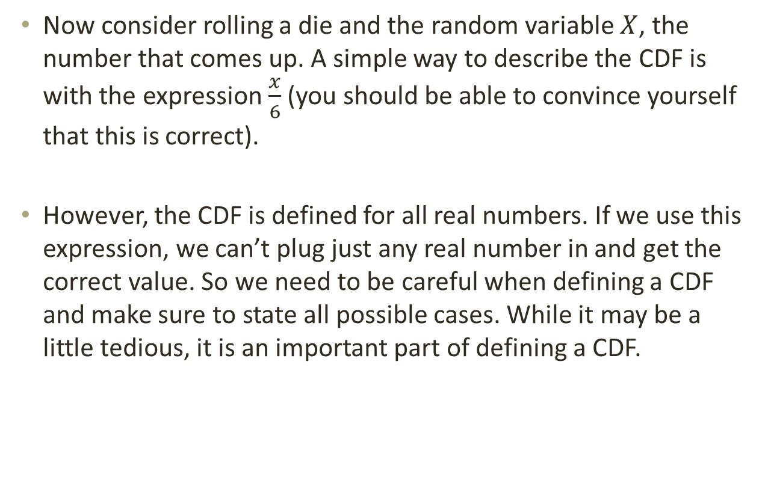
3.2 – Discrete Probability Distributions
Now consider rolling a die and the random variable $X$, the number that comes up. A simple way to describe the CDF is with the expression $\frac{x}{6}$ (you should be able to convince yourself that this is correct).
However, the CDF is defined for all real numbers. If we use this expression, we can’t plug just any real number in and get the correct value. So we need to be careful when defining a CDF and make sure to state all possible cases. While it may be a little tedious, it is an important part of defining a CDF.

Slide 24
3.2 – Discrete Probability Distributions
The CDF as defined on the board is almost correct. What’s wrong with it? Any ideas on how to fix it?
As a hint try drawing the CDF.

Slide 25
3.2 – Discrete Probability Distributions
We have made a CDF for a continuous random variable. What should the picture look like instead?
How can we fix this in the definition of the CDF?

Slide 26
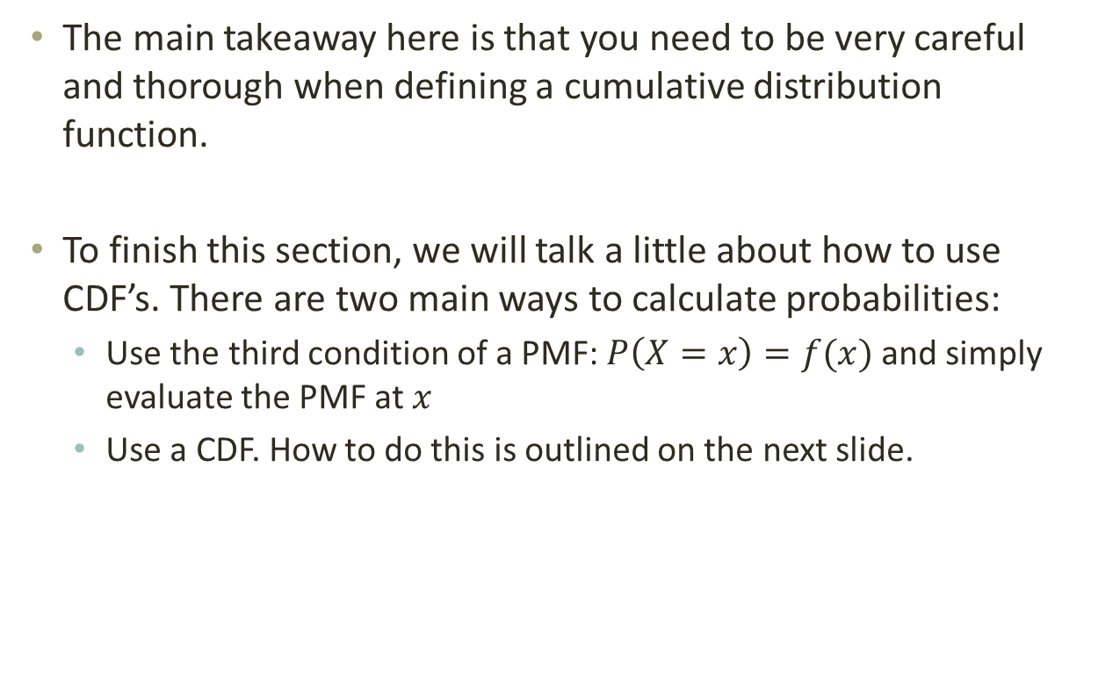
3.2 – Discrete Probability Distributions
The main takeaway here is that you need to be very careful and thorough when defining a cumulative distribution function.
To finish this section, we will talk a little about how to use CDF’s. There are two main ways to calculate probabilities:
  Use the third condition of a PMF: $P\left(X=x\right)=f(x)$ and simply evaluate the PMF at $x$
  Use a CDF. How to do this is outlined on the next slide.

Slide 27
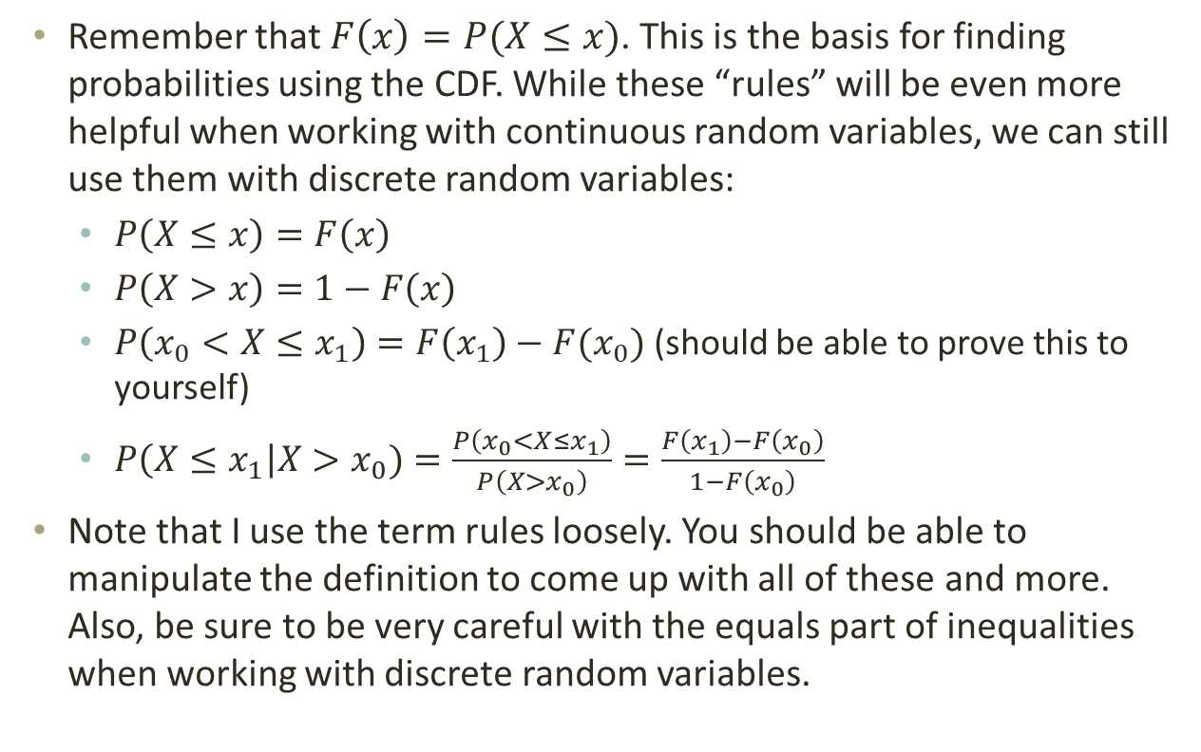
3.2 – Discrete Probability Distributions
Remember that $F\left(x\right)=P(X≤x)$. This is the basis for finding probabilities using the CDF. While these “rules” will be even more helpful when working with continuous random variables, we can still use them with discrete random variables:
  $P\left(X≤x\right)=F\left(x\right)$
  $P\left(X>x\right)=1−F\left(x\right)$
  $P\left(x_{0}<X≤x_{1}\right)=F\left(x_{1}\right)−F(x_{0})$ (should be able to prove this to yourself)
  $P\left(X≤x_{1}\right|X>x_{0})=\frac{P\left(x_{0}<X≤x_{1}\right)}{P\left(X>x_{0}\right)}=\frac{F\left(x_{1}\right)−F\left(x_{0}\right)}{1−F\left(x_{0}\right)}$
Note that I use the term rules loosely. You should be able to manipulate the definition to come up with all of these and more. Also, be sure to be very careful with the equals part of inequalities when working with discrete random variables.

Slide 28

3.2 – Discrete Probability Distributions
Exercises: Let the random variable $W$ be the sum of the numbers on two dice.
  Find the PMF (can give as a table or as a formula)
  Find the CDF (make sure to define carefully)
  Find P($X=7)$, $P(X≥3)$, $P(5< X<10)$, and $P\left(X≤8\right|X≥4)$

Slide 29
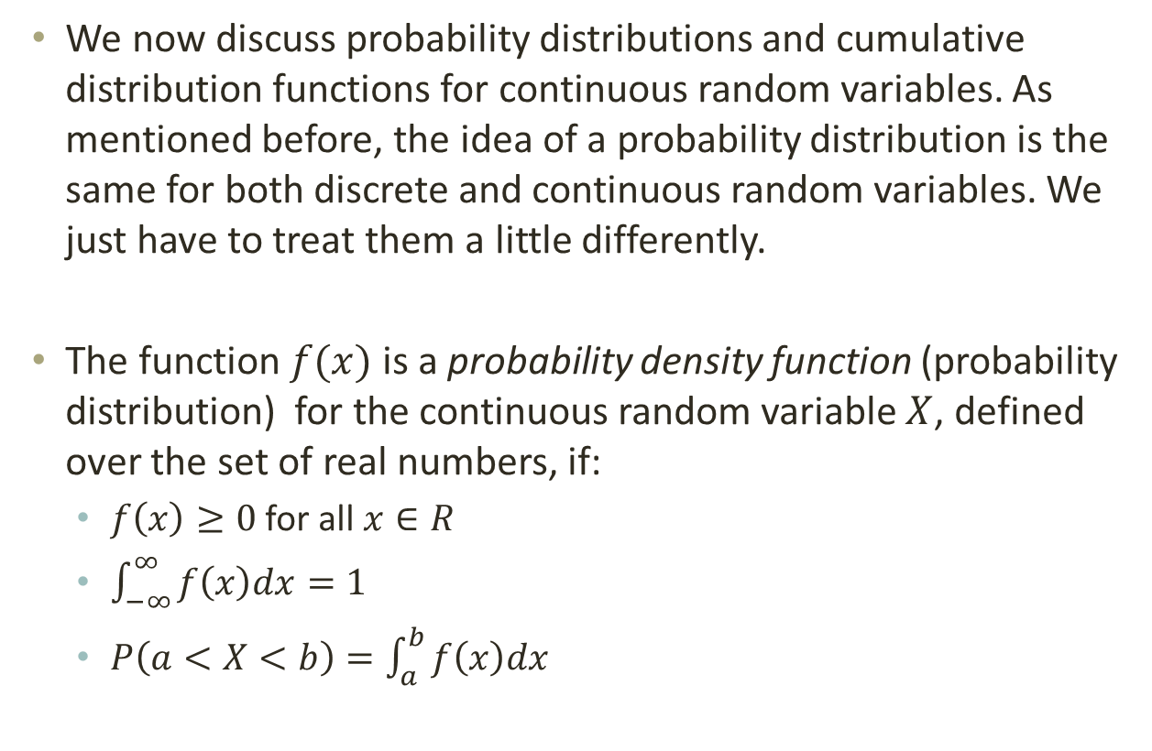
3.3 – Continuous Probability Distributions
We now discuss probability distributions and cumulative distribution functions for continuous random variables. As mentioned before, the idea of a probability distribution is the same for both discrete and continuous random variables. We just have to treat them a little differently.
The function $f(x)$ is a probability density function (probability distribution) for the continuous random variable $X$, defined over the set of real numbers, if:
  $f\left(x\right)≥0$ for all $x∈R$
  $\int_{−∞}^{∞}{f\left(x\right)dx=1}$
  $P\left(a<X<b\right)=\int_{a}^{b}{f\left(x\right)dx}$

Slide 30
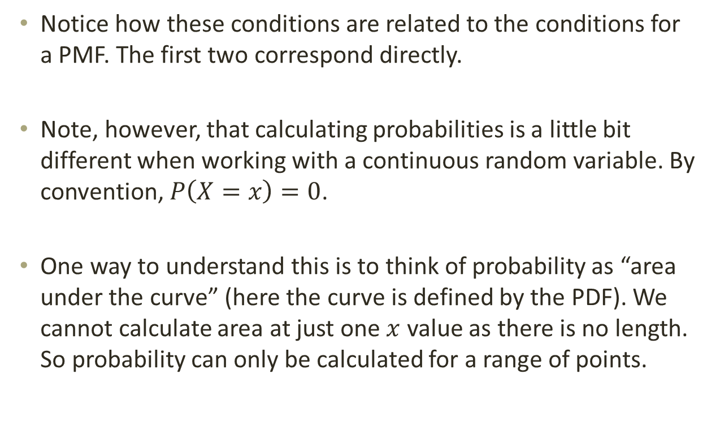
3.3 – Continuous Probability Distributions
Notice how these conditions are related to the conditions for a PMF. The first two correspond directly.
Note, however, that calculating probabilities is a little bit different when working with a continuous random variable. By convention, $P\left(X=x\right)=0$.
One way to understand this is to think of probability as “area under the curve” (here the curve is defined by the PDF). We cannot calculate area at just one $x$ value as there is no length. So probability can only be calculated for a range of points.

Slide 31
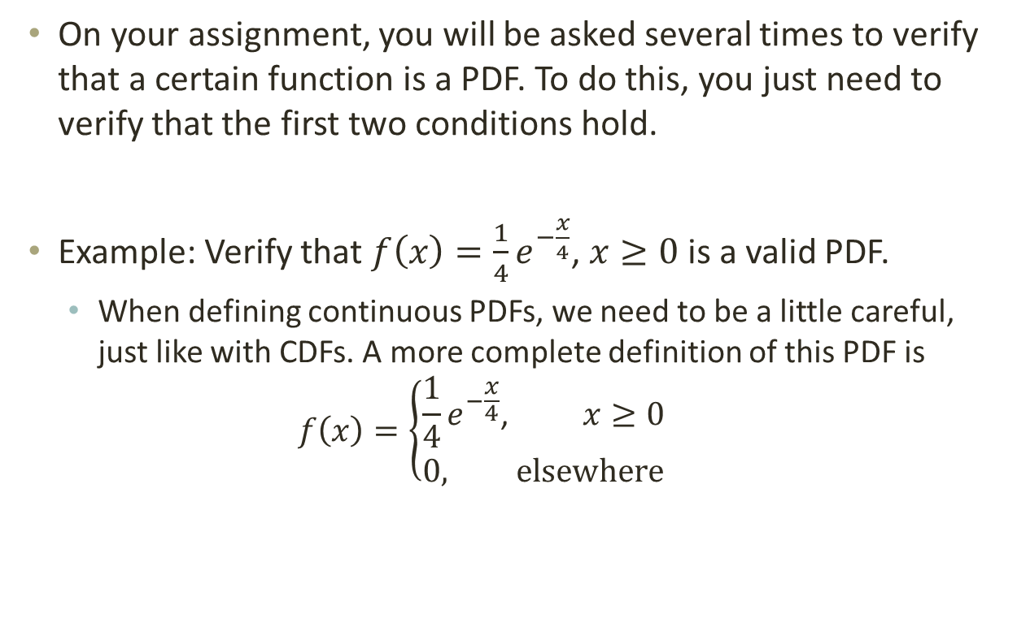
3.3 – Continuous Probability Distributions
On your assignment, you will be asked several times to verify that a certain function is a PDF. To do this, you just need to verify that the first two conditions hold.
Example: Verify that $f\left(x\right)=\frac{1}{4}e^{−\frac{x}{4}}$, $x≥0$ is a valid PDF.
  When defining continuous PDFs, we need to be a little careful, just like with CDFs. A more complete definition of this PDF is
  $$f\left(x\right)=\left\{\begin{aligned}\frac{1}{4}e^{−\frac{x}{4}}\text{,} x≥0 \\ 0, elsewhere\end{aligned}\right.$$

Slide 32

3.3 – Continuous Probability Distributions
Just like we did with discrete distributions, we can also find values that will make a function a PDF.
Exercise: A function is defined by $f\left(x\right)=k\cos{x}$ for $x∈\left[−\frac{π}{2}, \frac{π}{2}\right]$ and $0$ elsewhere. Find $k$ such that $f(x)$ is a valid PDF.

Slide 33
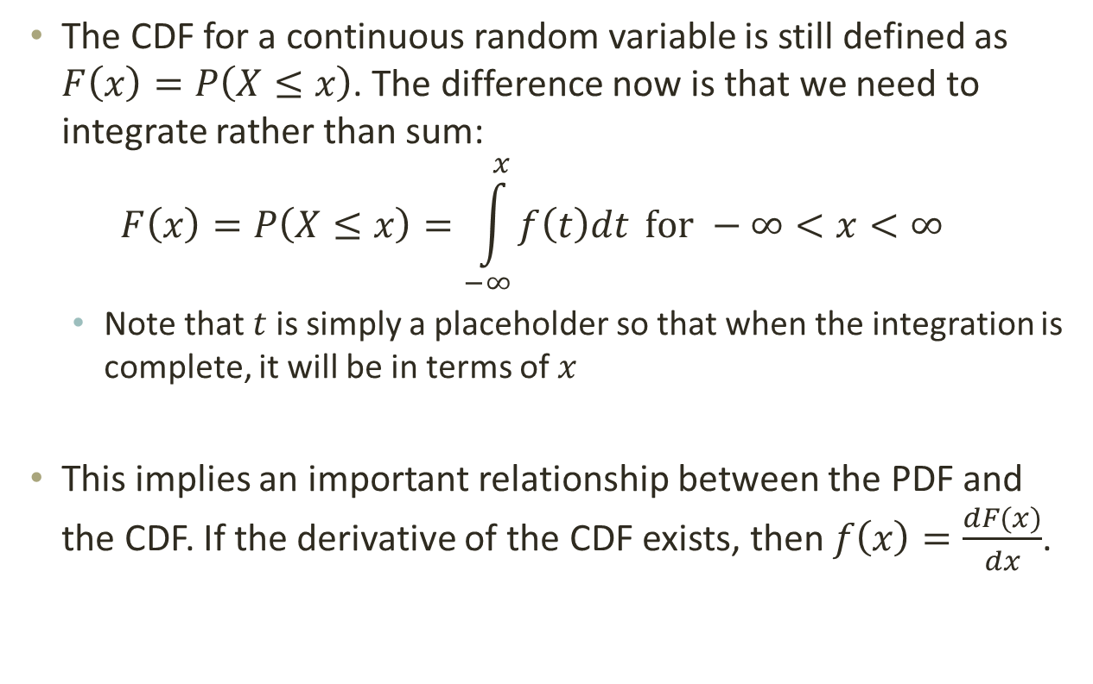
3.3 – Continuous Probability Distributions
The CDF for a continuous random variable is still defined as $F\left(x\right)=P\left(X≤x\right)$. The difference now is that we need to integrate rather than sum:
$$F\left(x\right)=P\left(X≤x\right)=\int_{−∞}^{x}{f\left(t\right)dt} for −∞<x<∞$$
  Note that $t$is simply a placeholder so that when the integration is complete, it will be in terms of $x$
This implies an important relationship between the PDF and the CDF. If the derivative of the CDF exists, then $f\left(x\right)=\frac{dF(x)}{dx}$.

Slide 34
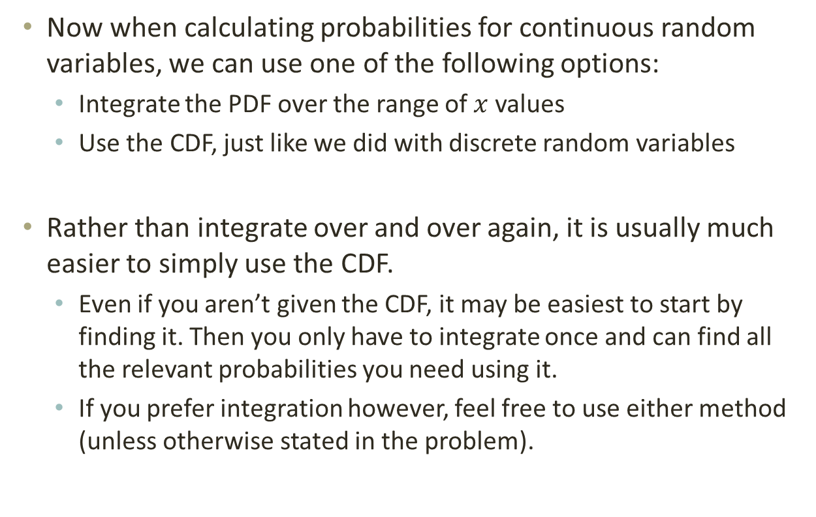
3.3 – Continuous Probability Distributions
Now when calculating probabilities for continuous random variables, we can use one of the following options:
  Integrate the PDF over the range of $x$ values
  Use the CDF, just like we did with discrete random variables
Rather than integrate over and over again, it is usually much easier to simply use the CDF.
  Even if you aren’t given the CDF, it may be easiest to start by finding it. Then you only have to integrate once and can find all the relevant probabilities you need using it.
  If you prefer integration however, feel free to use either method (unless otherwise stated in the problem).

Slide 35
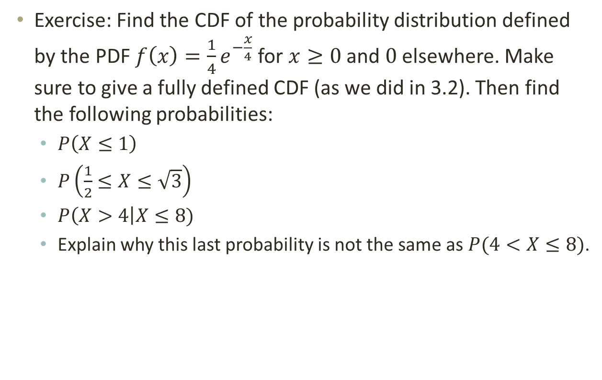
3.3 – Continuous Probability Distributions
Exercise: Find the CDF of the probability distribution defined by the PDF $f\left(x\right)=\frac{1}{4}e^{−\frac{x}{4}}$ for $x≥0$ and $0$ elsewhere. Make sure to give a fully defined CDF (as we did in 3.2). Then find the following probabilities:
  $P\left(X≤1\right)$
  $P\left(\frac{1}{2}≤X≤\sqrt{3}\right)$
  $P\left(X>4\right|X≤8)$
  Explain why this last probability is not the same as $P(4<X≤8)$.

Slide 36
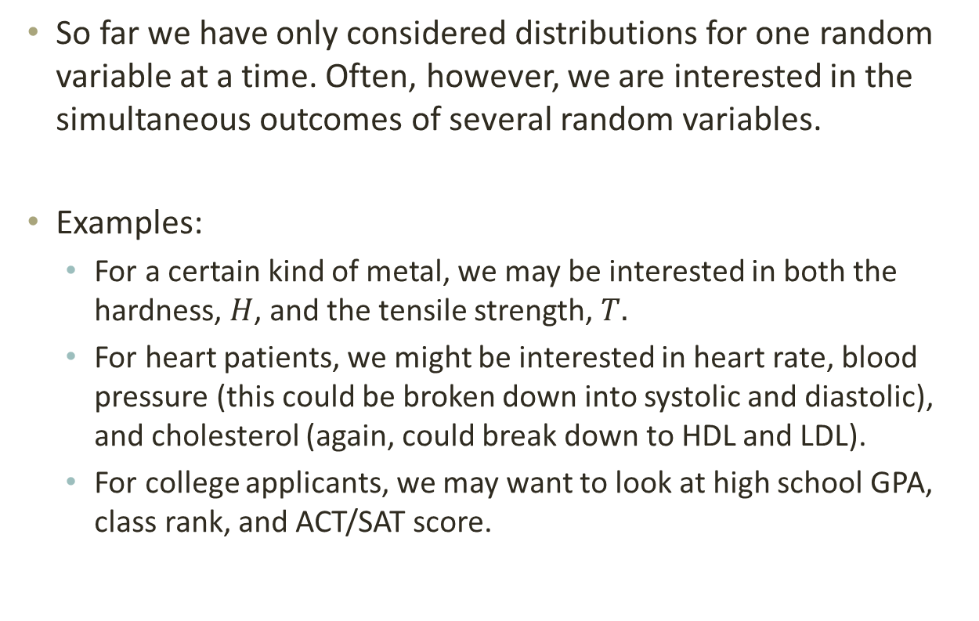
3.4 – Joint Probability Distributions
So far we have only considered distributions for one random variable at a time. Often, however, we are interested in the simultaneous outcomes of several random variables.
Examples:
  For a certain kind of metal, we may be interested in both the hardness, $H$, and the tensile strength, $T.$
  For heart patients, we might be interested in heart rate, blood pressure (this could be broken down into systolic and diastolic), and cholesterol (again, could break down to HDL and LDL).
  For college applicants, we may want to look at high school GPA, class rank, and ACT/SAT score.

Slide 37
3.4 – Joint Probability Distributions
In each of these examples, there are at least 2 random variables that we are interested in looking at. In order to work with more than one random variable at a time, we need to use a joint probability distribution.
The idea is that we can look at how both of the variables are distributed simultaneously. One benefit of joint distributions is that we can use them to understand the relationship between two or more variables.
We start with the discrete case for two random variables.

Slide 38
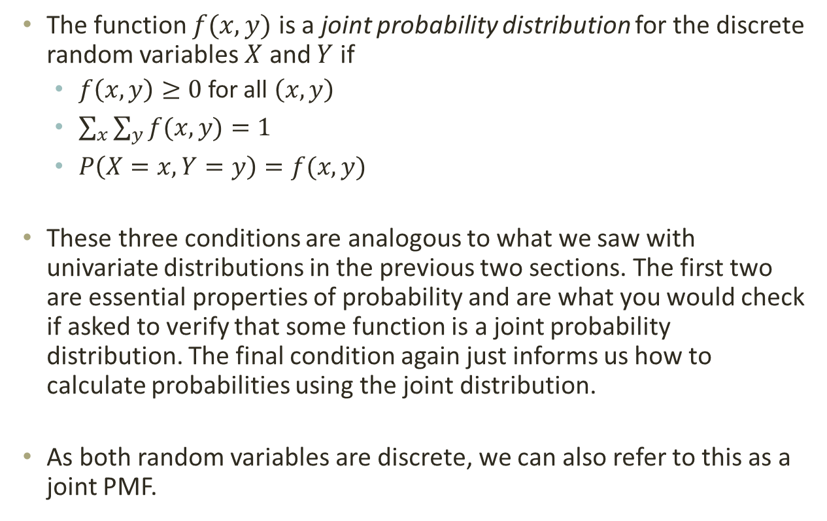
3.4 – Joint Probability Distributions
The function $f(x,y)$ is a joint probability distribution for the discrete random variables $X$ and $Y$ if
  $f\left(x,y\right)≥0$ for all $\left(x,y\right)$
  $\sum_{x}{\sum_{y}{f(x,y)}=1}$
  $P\left(X=x,Y=y\right)=f(x,y)$
These three conditions are analogous to what we saw with univariate distributions in the previous two sections. The first two are essential properties of probability and are what you would check if asked to verify that some function is a joint probability distribution. The final condition again just informs us how to calculate probabilities using the joint distribution.
As both random variables are discrete, we can also refer to this as a joint PMF.

Slide 39
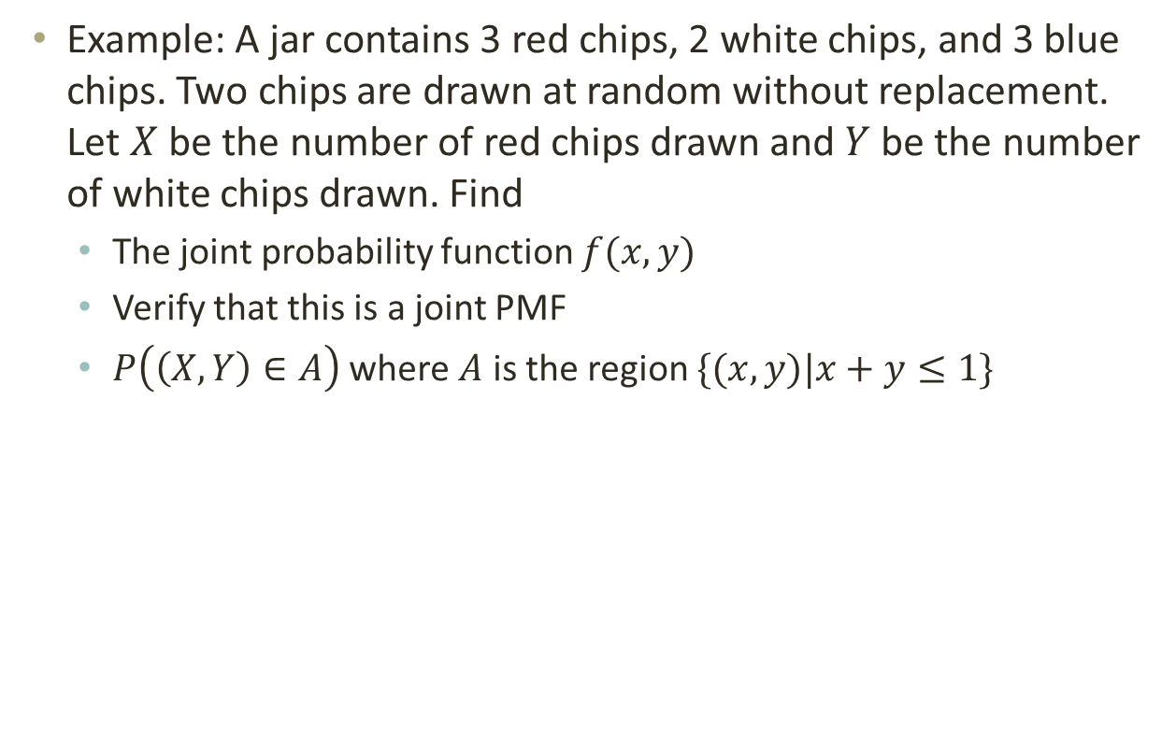
3.4 – Joint Probability Distributions
Example: A jar contains 3 red chips, 2 white chips, and 3 blue chips. Two chips are drawn at random without replacement. Let $X$ be the number of red chips drawn and $Y$ be the number of white chips drawn. Find
  The joint probability function $f(x,y)$
  Verify that this is a joint PMF
  $P\left(\left(X,Y\right)∈A\right)$ where $A$ is the region $\{(x,y)|x+y≤1\}$

Slide 40
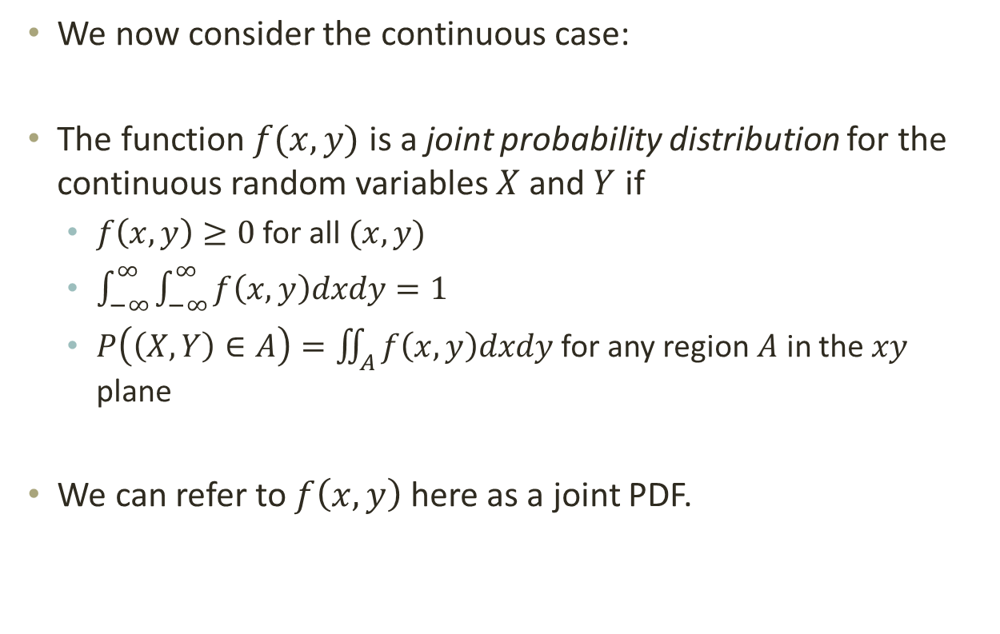
3.4 – Joint Probability Distributions
We now consider the continuous case:
The function $f(x,y)$ is a joint probability distribution for the continuous random variables $X$ and $Y$ if
  $f\left(x,y\right)≥0$ for all $(x,y)$
  $\int_{−∞}^{∞}{\int_{−∞}^{∞}{f\left(x,y\right)dxdy}}=1$
  $P\left(\left(X,Y\right)∈A\right)=\iint_{A}^{ }{f\left(x,y\right)dxdy}$ for any region $A$ in the $xy$ plane
We can refer to $f\left(x,y\right)$ here as a joint PDF.

Slide 41
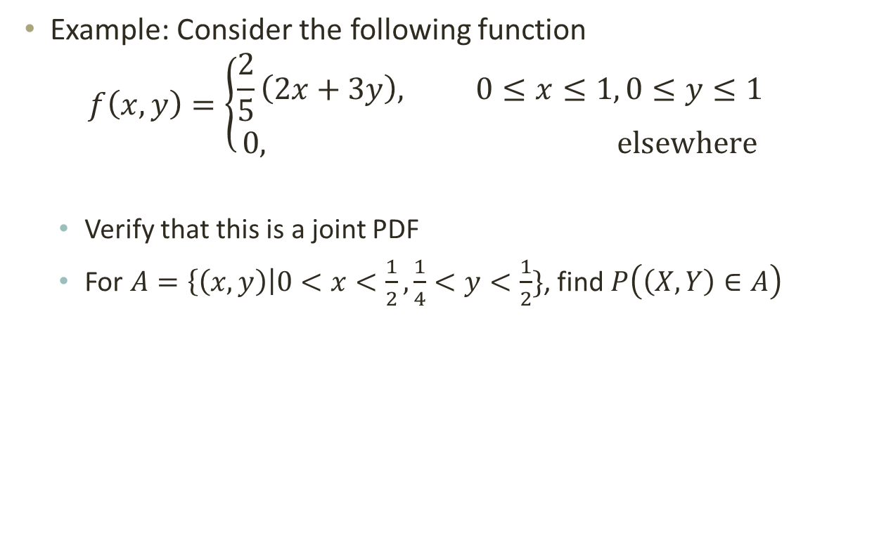
3.4 – Joint Probability Distributions
Example: Consider the following function
$$f\left(x,y\right)=\left\{\begin{aligned}\frac{2}{5}\left(2x+3y\right), 0≤x≤1, 0≤y≤1 \\ 0, elsewhere\end{aligned} \right.$$
  Verify that this is a joint PDF
  For $A=\left\{\left(x,y\right)\right|0<x<\frac{1}{2},\frac{1}{4}<y<\frac{1}{2}\}$, find $P\left(\left(X,Y\right)∈A\right)$

Slide 42
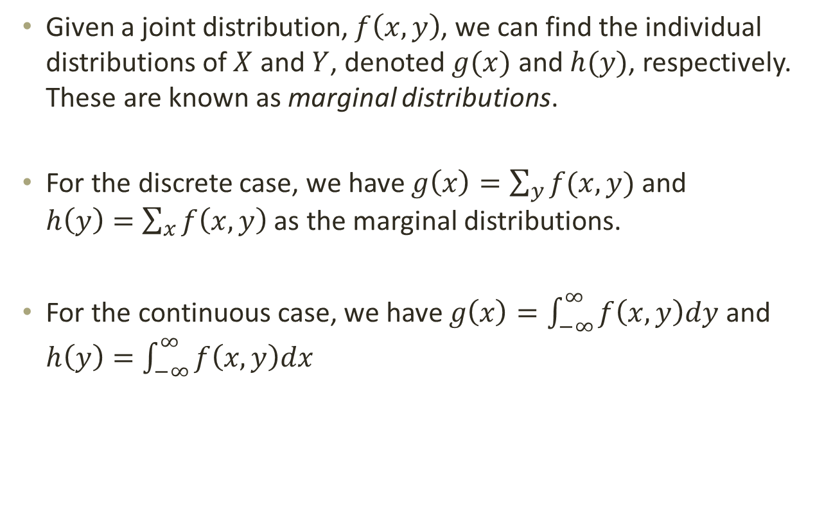
3.4 – Joint Probability Distributions
Given a joint distribution, $f\left(x,y\right)$, we can find the individual distributions of $X$ and $Y$, denoted $g(x)$ and $h(y)$, respectively. These are known as marginal distributions.
For the discrete case, we have $g\left(x\right)=\sum_{y}{f(x,y)}$ and $h\left(y\right)=\sum_{x}{f\left(x,y\right)}$ as the marginal distributions.
For the continuous case, we have $g\left(x\right)=\int_{−∞}^{∞}{f\left(x,y\right)dy}$ and $h\left(y\right)=\int_{−∞}^{∞}{f\left(x,y\right)dx}$

Slide 43
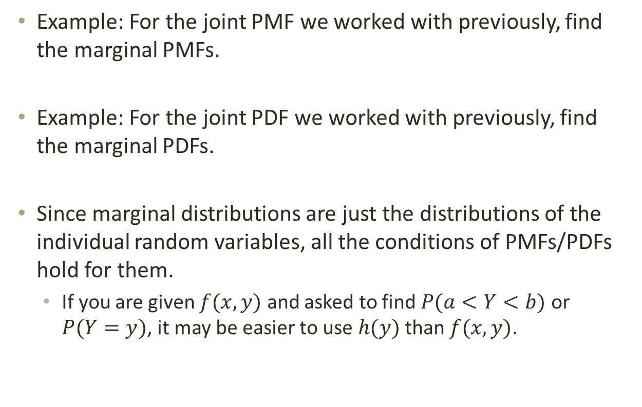
3.4 – Joint Probability Distributions
Example: For the joint PMF we worked with previously, find the marginal PMFs.
Example: For the joint PDF we worked with previously, find the marginal PDFs.
Since marginal distributions are just the distributions of the individual random variables, all the conditions of PMFs/PDFs hold for them.
  If you are given $f(x,y)$ and asked to find $P(a<Y<b)$ or $P(Y=y)$, it may be easier to use $h(y)$ than $f(x,y)$.

Slide 44
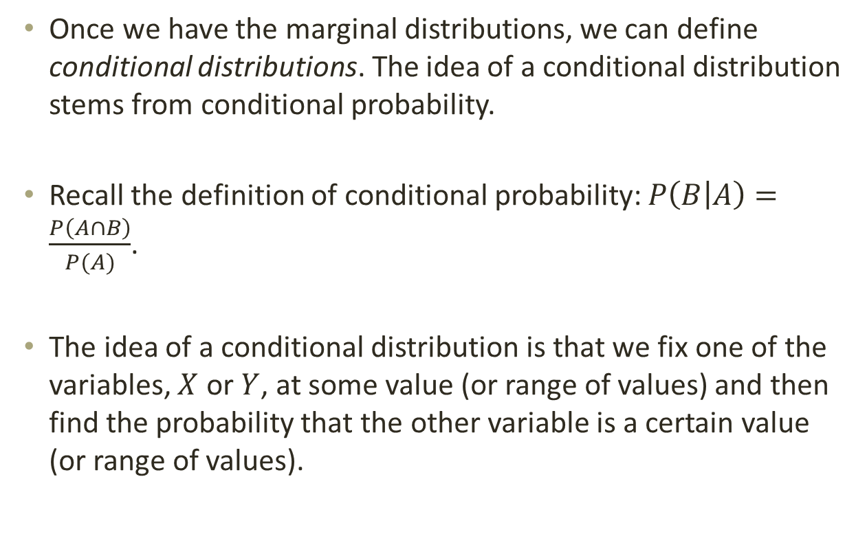
3.4 – Joint Probability Distributions
Once we have the marginal distributions, we can define conditional distributions. The idea of a conditional distribution stems from conditional probability.
Recall the definition of conditional probability: $P\left(B | A\right)=\frac{P\left(A∩B\right)}{P(A)}$.
The idea of a conditional distribution is that we fix one of the variables, $X$ or $Y$, at some value (or range of values) and then find the probability that the other variable is a certain value (or range of values).

Slide 45
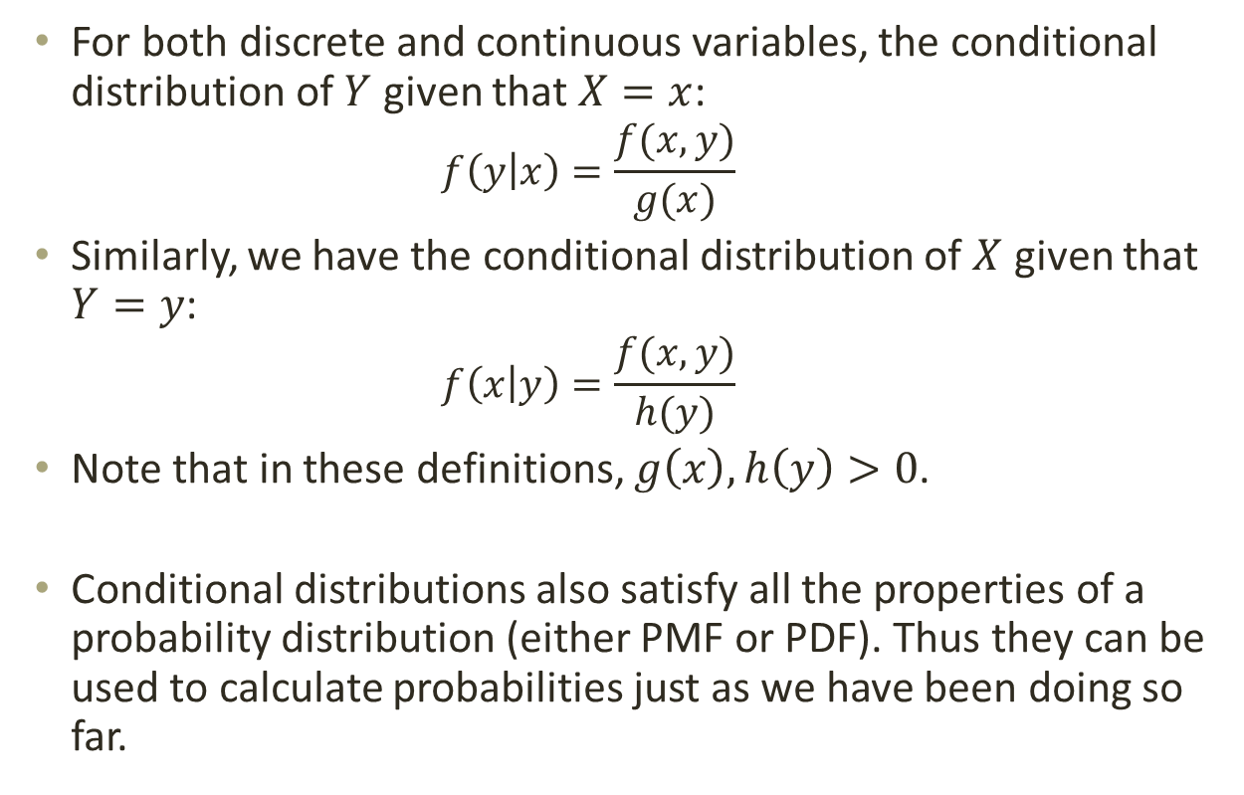
3.4 – Joint Probability Distributions
For both discrete and continuous variables, the conditional distribution of $Y$ given that $X=x$:
  $$f\left(y | x\right)=\frac{f(x,y)}{g(x)}$$
Similarly, we have the conditional distribution of $X$ given that $Y=y$:
  $$f\left(x | y\right)=\frac{f(x,y)}{h(y)}$$
Note that in these definitions, $g\left(x\right),h\left(y\right)>0$.
Conditional distributions also satisfy all the properties of a probability distribution (either PMF or PDF). Thus they can be used to calculate probabilities just as we have been doing so far.

Slide 46

3.4 – Joint Probability Distributions
Example: Using the joint PMF we have been using so far, find the conditional distribution of $X$ given that $Y=0$.

Slide 47
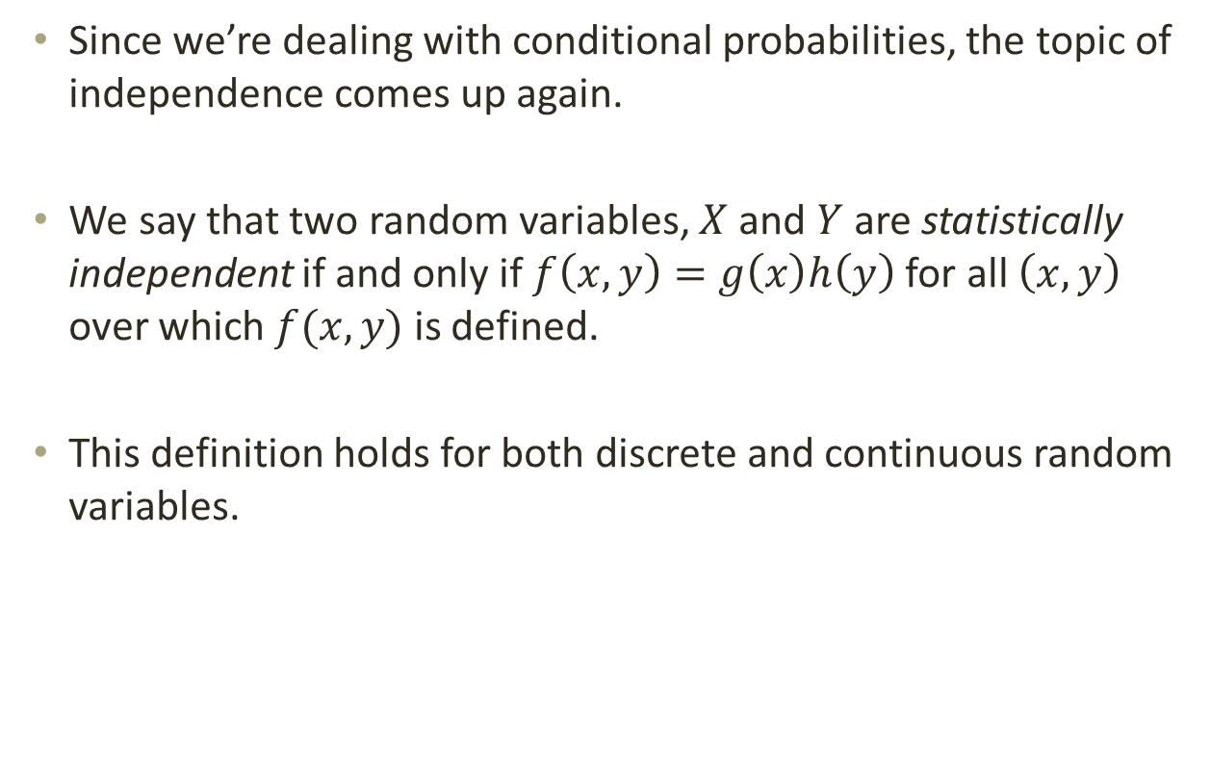
3.4 – Joint Probability Distributions
Since we’re dealing with conditional probabilities, the topic of independence comes up again.
We say that two random variables, $X$ and $Y$ are statistically independent if and only if $f\left(x,y\right)=g\left(x\right)h\left(y\right)$ for all $\left(x,y\right)$ over which $f(x,y)$ is defined.
This definition holds for both discrete and continuous random variables.

Slide 48
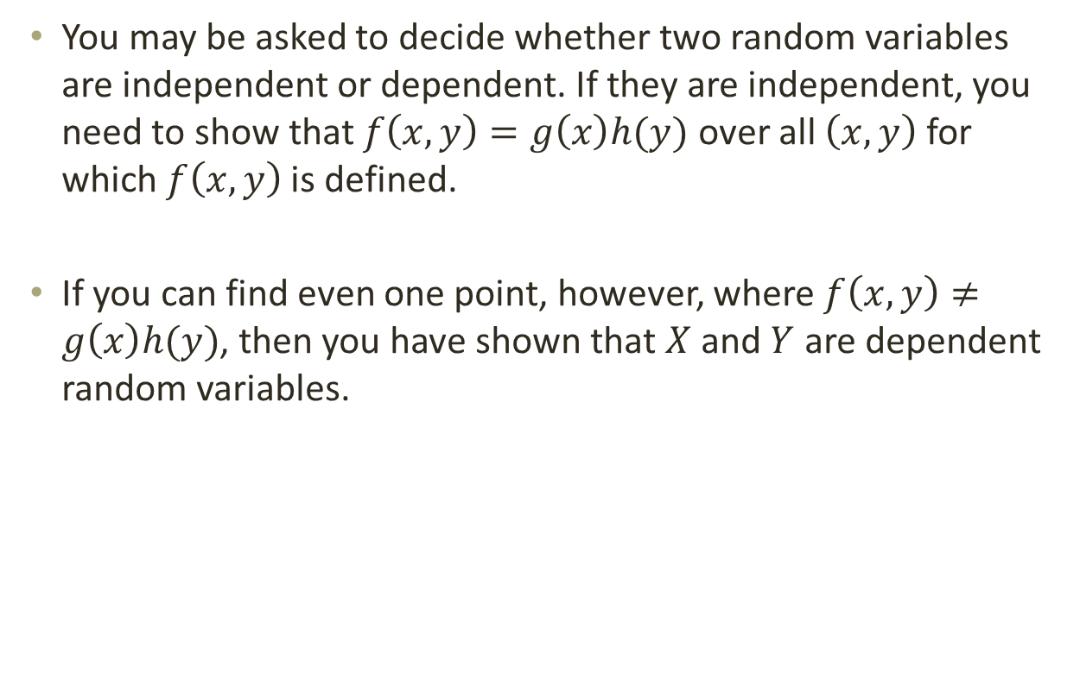
3.4 – Joint Probability Distributions
You may be asked to decide whether two random variables are independent or dependent. If they are independent, you need to show that $f\left(x,y\right)=g\left(x\right)h(y)$ over all $\left(x,y\right)$ for which $f\left(x,y\right)$ is defined.
If you can find even one point, however, where $f\left(x,y\right)≠g\left(x\right)h(y)$, then you have shown that $X$ and $Y$ are dependent random variables.

Slide 49
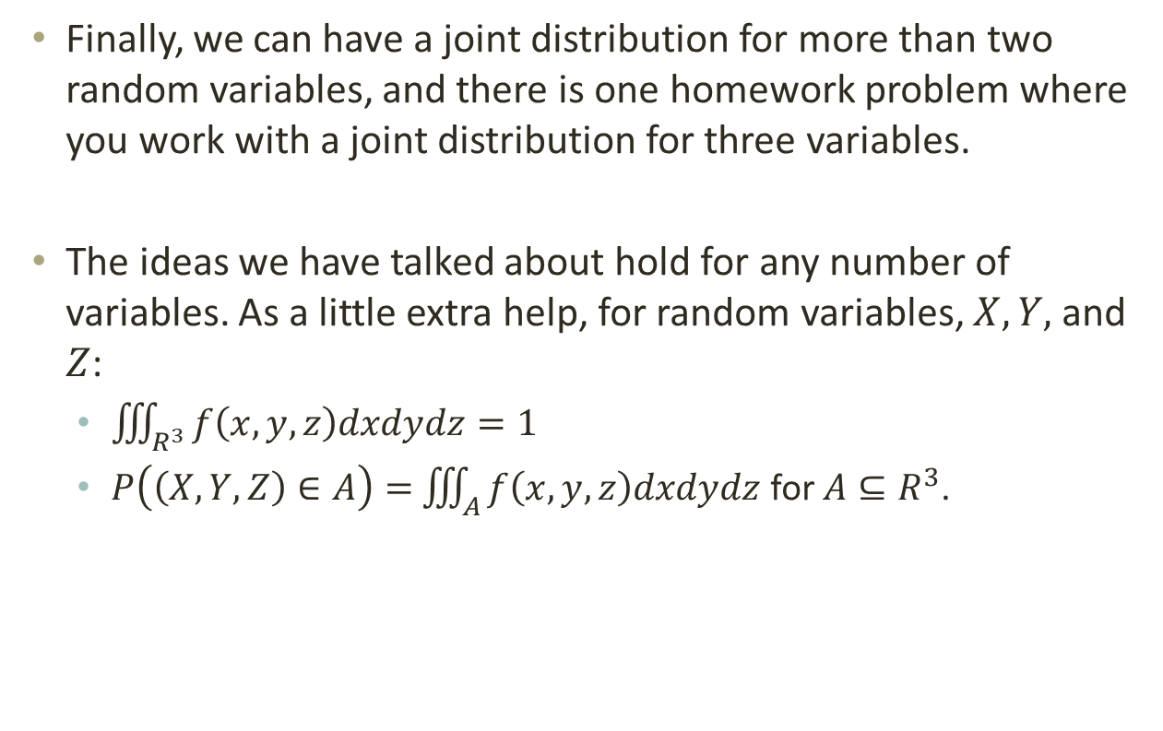
3.4 – Joint Probability Distributions
Finally, we can have a joint distribution for more than two random variables, and there is one homework problem where you work with a joint distribution for three variables.
The ideas we have talked about hold for any number of variables. As a little extra help, for random variables, $X, Y,$ and $Z$:
  $\iiint_{R^{3}}^{ }{f\left(x,y,z\right)dxdydz=1}$
  $P\left(\left(X,Y,Z\right)∈A\right)=$ $\iiint_{A}^{ }{f\left(x,y,z\right)dxdydz}$ for $A⊆R^{3}$.

